Slide 1
Dynamic Programming for Competitive Programming
March 12, 2024
CUNE Programming Team Practice

Slide 2
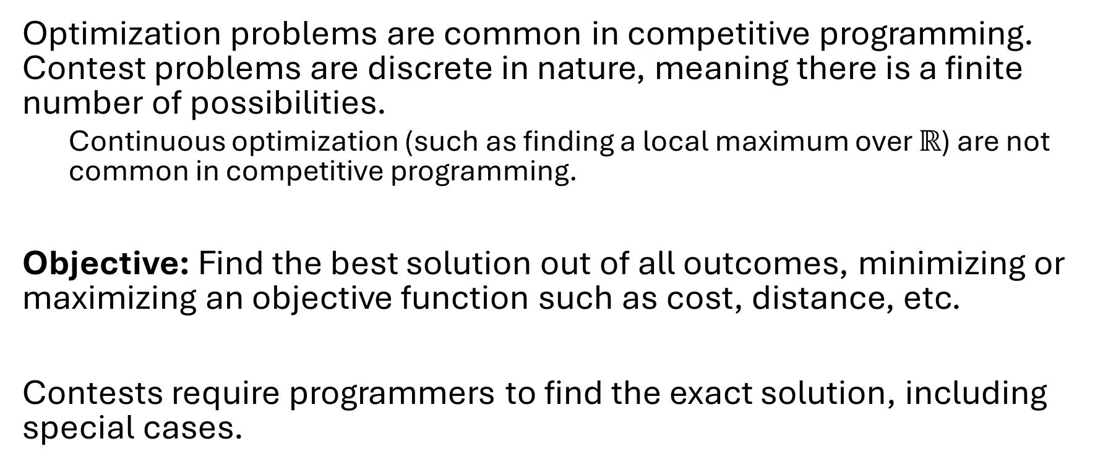
Optimization Problems
Optimization problems are common in competitive programming. Contest problems are discrete in nature, meaning there is a finite number of possibilities.
Continuous optimization (such as finding a local maximum over $ℝ$) are not common in competitive programming.
Objective: Find the best solution out of all outcomes, minimizing or maximizing an objective function such as cost, distance, etc.
Contests require programmers to find the exact solution, including special cases.

Slide 3
Brute Force Solutions
Definition: an exhaustive search that checks all possible solutions.
Approach: Iterate or recurse through all possible solutions, evaluating each as a possible optimal solution.
Pros: Conceptually simple and easy to implement. Guaranteed to find an optimal solution if it exists.
Cons: Inefficient on large input sizes. Oftentimes exponential complexity. Thus, impractical in many settings and problems.

Slide 4
Dynamic Programming
Definition: strategy for finding an optimal solution by breaking down a problem into subproblems and avoiding redundant calculations.
Approach: break down problem into smaller, overlapping subproblems such that subproblems are solved once and combined in the solution.
Pros: efficient even for large inputs. Guaranteed to find the optimal solution if designed correctly. Less than exponential complexity.
Cons: requires careful analysis of the problem and design of a solution. Often challenging to implement and debug.

Slide 5
Dynamic Programming Methods
Each problem requires a different dynamic programming solution. Solutions come in two general forms.
Tabulation (Bottom-Up): iteratively (using loops) solve subproblems, starting with the smallest and combining them into solutions to larger subproblems until you reach the main problem.
Memoization (Top-Down): recursively solve subproblems designing a function to solve the main problem by recursively solving smaller problems. The recursion ends at the smallest case.

Slide 6
Counting Problems
Traditionally, dynamic programming is used for optimization, but the same ideas work for counting problems. These are also common in competitive programming.
Objective: count the total number of ways some condition occurs in a large set of outcomes.
Breaking the counting into subproblems and using Tabulation and Memoization allows for increased efficiency.

Slide 7
Resources for Dynamic Programming
Intro: https://stackoverflow.blog/2022/01/31/the-complete-beginners-guide-to-dynamic-programming/
Academic Examples: https://www.enjoyalgorithms.com/blog/what-common-problems-solved-using-dynamic-programming
Competitive Overview: https://www.topcoder.com/thrive/articles/Dynamic%20Programming:%20From%20Novice%20to%20Advanced

Slide 8
Advertising ICPC
NCNA Regional 2022
4 solved / 99 tries
A dynamic programming problem.

Slide 9
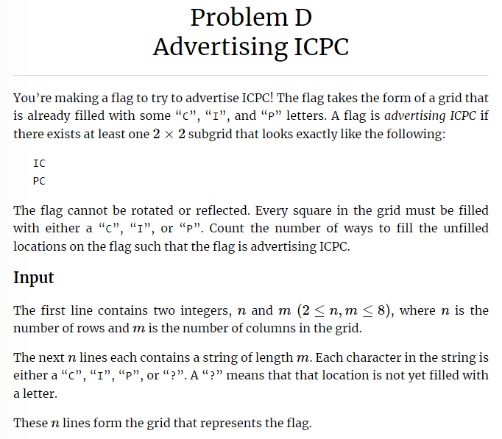
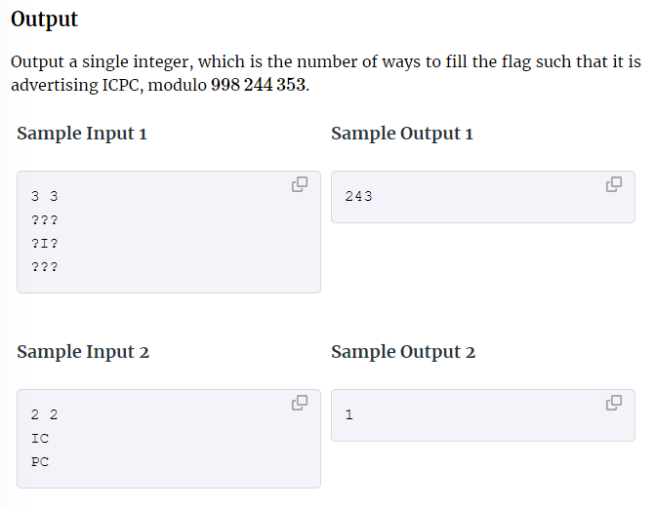
https://ncna22.kattis.com/contests/ncna22/problems/advertisingicpc

Slide 10
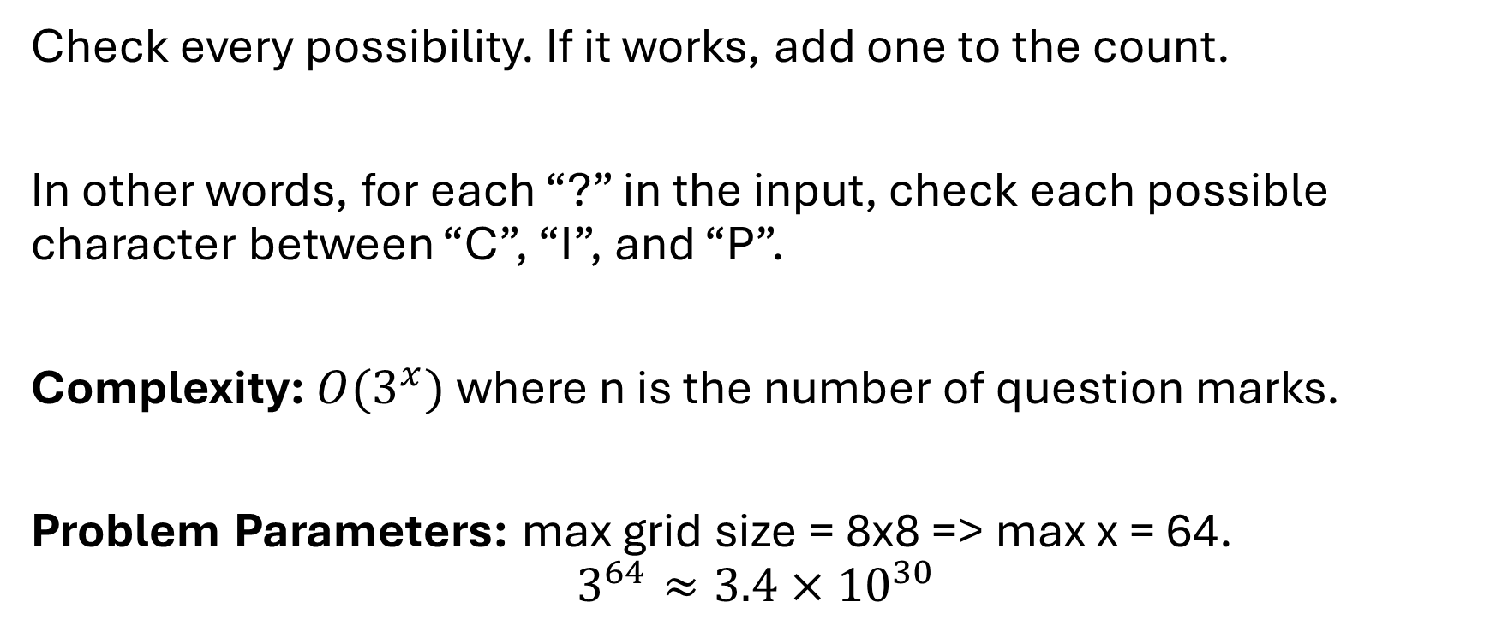
Brute Force Solution to the Counting Problem
Check every possibility. If it works, add one to the count.
In other words, for each “?” in the input, check each possible character between “C”, “I”, and “P”.
Complexity: $O(3^{x})$ where n is the number of question marks.
Problem Parameters: max grid size = 8x8 => max x = 64.
$$3^{64}≈3.4×{10}^{30}$$

Slide 11
Dynamic Programming Solution
Break down the main problem into subproblems.
Main Problem Sub Problems
3 3 2 2 2 2 2 2 2 2
??? ?? ?? ?I I?
?I? ?I I? ?? ??
???
For each subproblem, count how many ways it could Advertise ICPC.

Slide 12
Exponent Exchange
NCNA Regional 2022
3 solved / 72 tries
A hard dynamic programming problem.

Slide 13
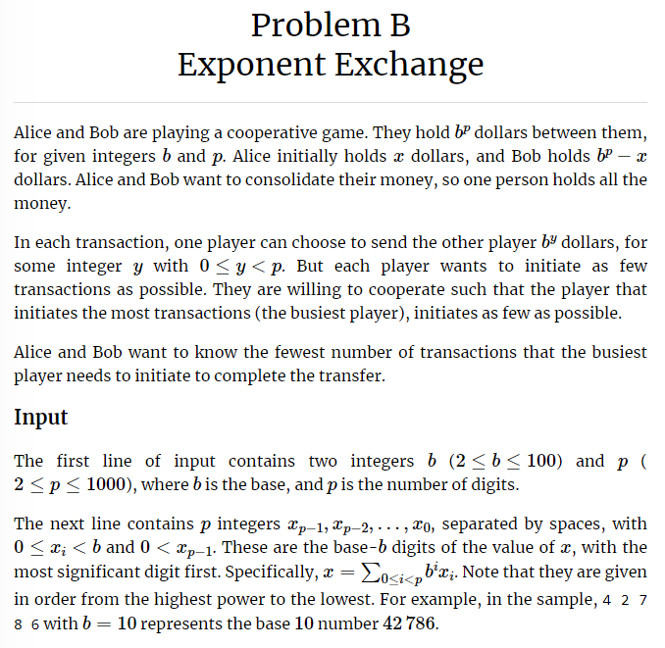
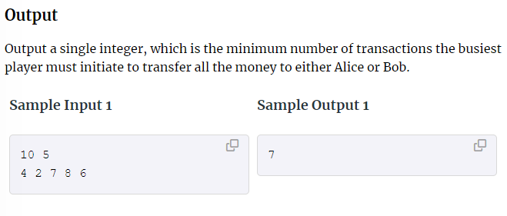
https://ncna22.kattis.com/contests/ncna22/problems/exponentexchange

Slide 14
Distilled Problem
For each base-b digit, Alice or Bob will transfer all of there dollars to the other.
Alice has:
4 2 7 8 6
For each digit d, either Alice transfers d to Bob or Bob transfers 10 – d.

Slide 15
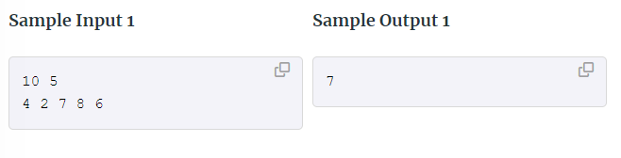
Working Out the Example
Alice starts with 42786 and Bob starts with 10000 – 42786 = 57214.
Bob gives Alice 4 1’s, 1 10, and 2 100’s, totaling to 7 transactions.
Bob now has 57000 and Alice has 43000.
Alice gives Bob 3 1000’s and then 4 10000’s, totaling 7 transactions.
Bob has all the money. Both players had 7 transactions. Output 7.

Slide 16
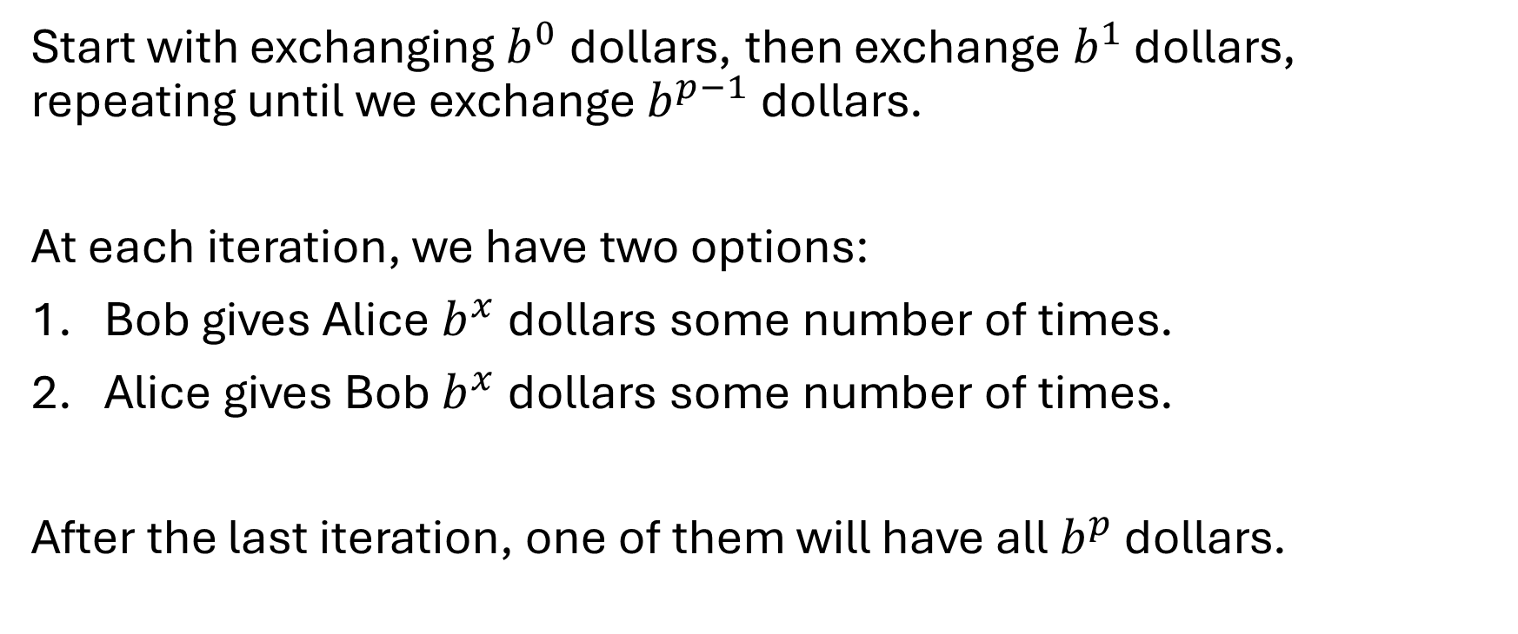
Solution Structure
Start with exchanging $b^{0}$ dollars, then exchange $b^{1}$ dollars, repeating until we exchange $b^{p−1}$ dollars.
At each iteration, we have two options:
Bob gives Alice $b^{x}$ dollars some number of times.
Alice gives Bob $b^{x}$ dollars some number of times.
After the last iteration, one of them will have all $b^{p}$ dollars.

Slide 17
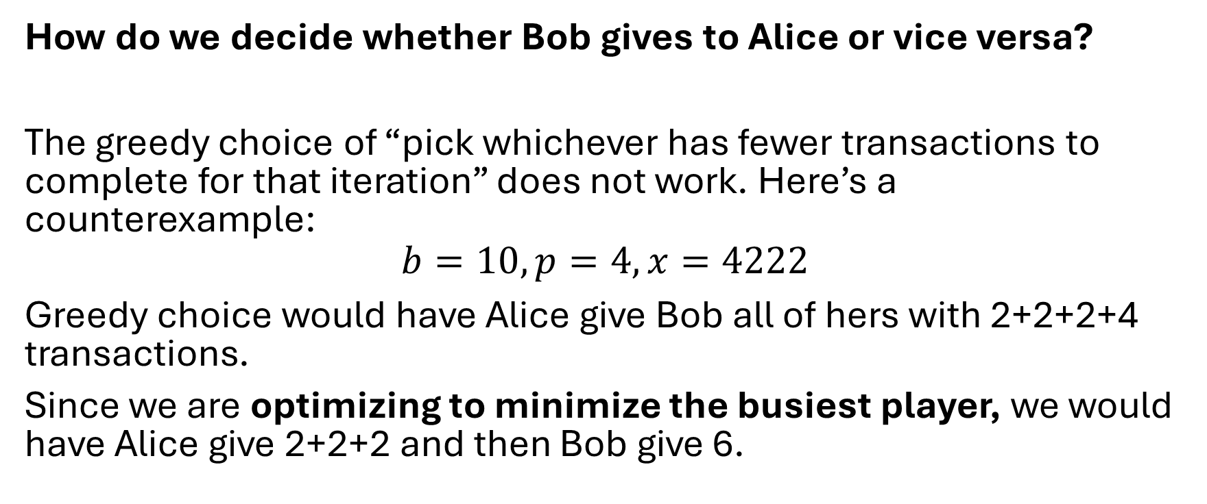
Key Question
How do we decide whether Bob gives to Alice or vice versa?
The greedy choice of “pick whichever has fewer transactions to complete for that iteration” does not work. Here’s a counterexample:
$$b=10, p=4, x=4222$$
Greedy choice would have Alice give Bob all of hers with 2+2+2+4 transactions.
Since we are optimizing to minimize the busiest player, we would have Alice give 2+2+2 and then Bob give 6.

Slide 18
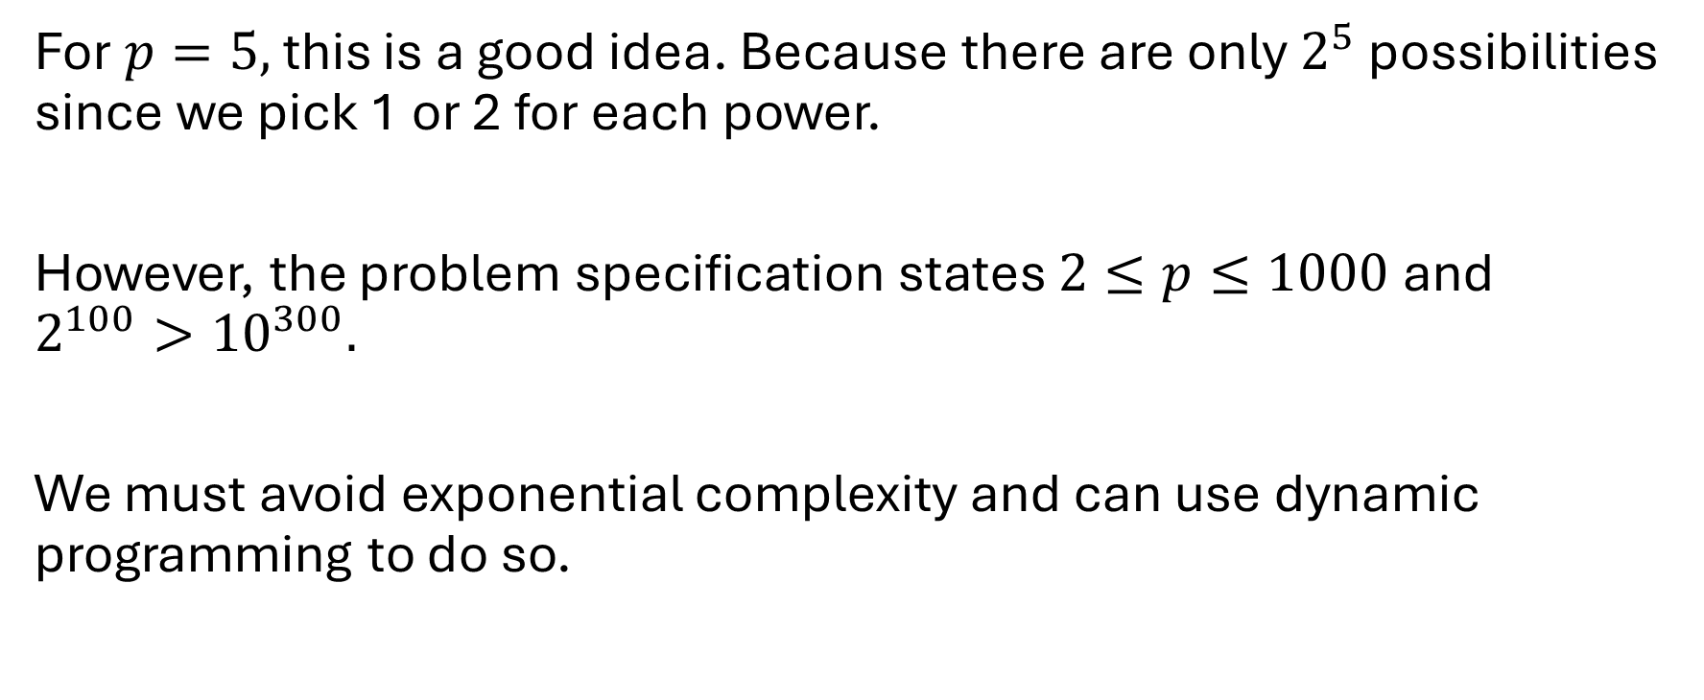
Let’s Check Every Possibility!...
For $p=5,$ this is a good idea. Because there are only $2^{5}$ possibilities since we pick 1 or 2 for each power.
However, the problem specification states $2≤p≤1000$ and $2^{100}>{10}^{300}.$
We must avoid exponential complexity and can use dynamic programming to do so.

Slide 19
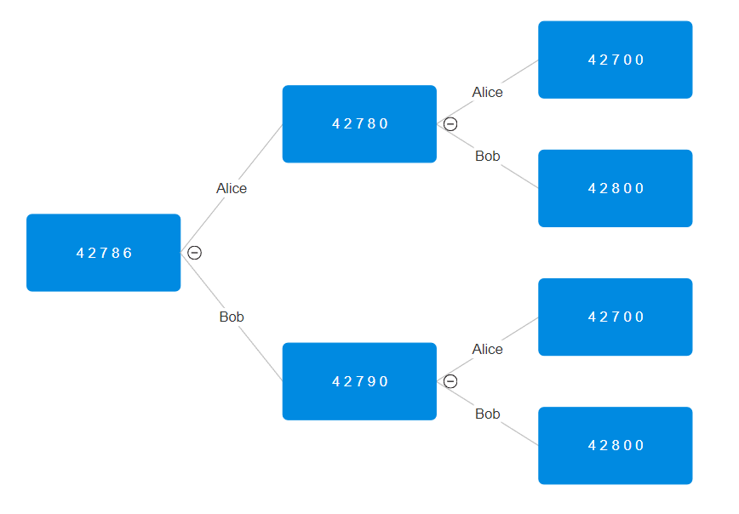
Solution Space
The tree will keep branching and eventually be too big to explore all possibilities.
However, we there are overlapping subproblems that we can leverage!

Slide 20
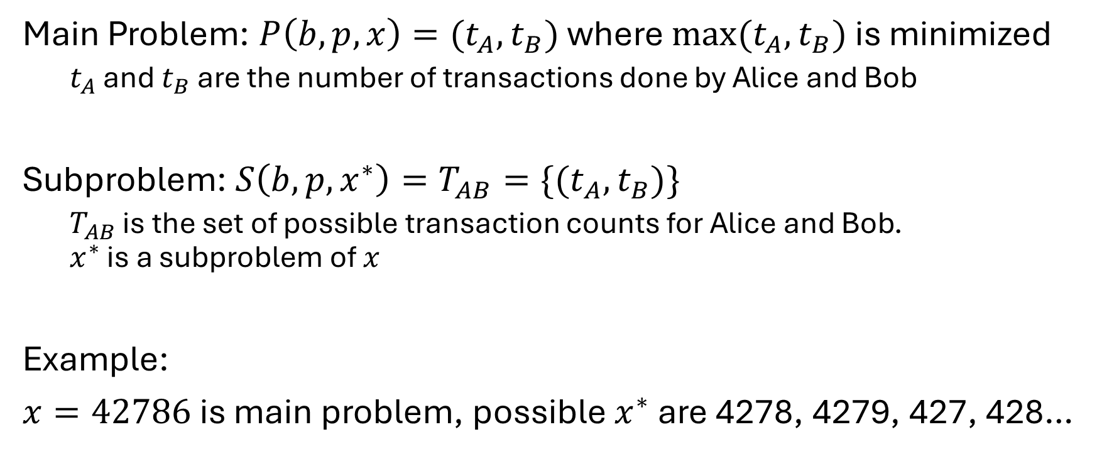
Define the Subproblem for Dynamic Programming
Main Problem: $P\left(b, p, x\right)=(t_{A}, t_{B})$ where $max(t_{A},t_{B})$ is minimized
$t_{A}$ and $t_{B}$ are the number of transactions done by Alice and Bob
Subproblem: $S\left(b,p,x^{∗}\right)=T_{AB}=\{{(t}_{A},t_{B})\}$
$T_{AB}$ is the set of possible transaction counts for Alice and Bob. $x^{∗}$ is a subproblem of $x$
Example:
$x=42786$ is main problem, possible $x^{∗}$ are 4278, 4279, 427, 428…

Slide 21
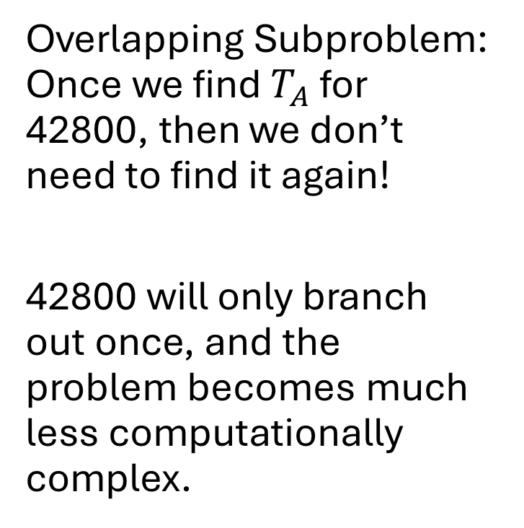
Overlapping Subproblem
Overlapping Subproblem: Once we find $T_{A}$ for 42800, then we don’t need to find it again!
42800 will only branch out once, and the problem becomes much less computationally complex.

Slide 22
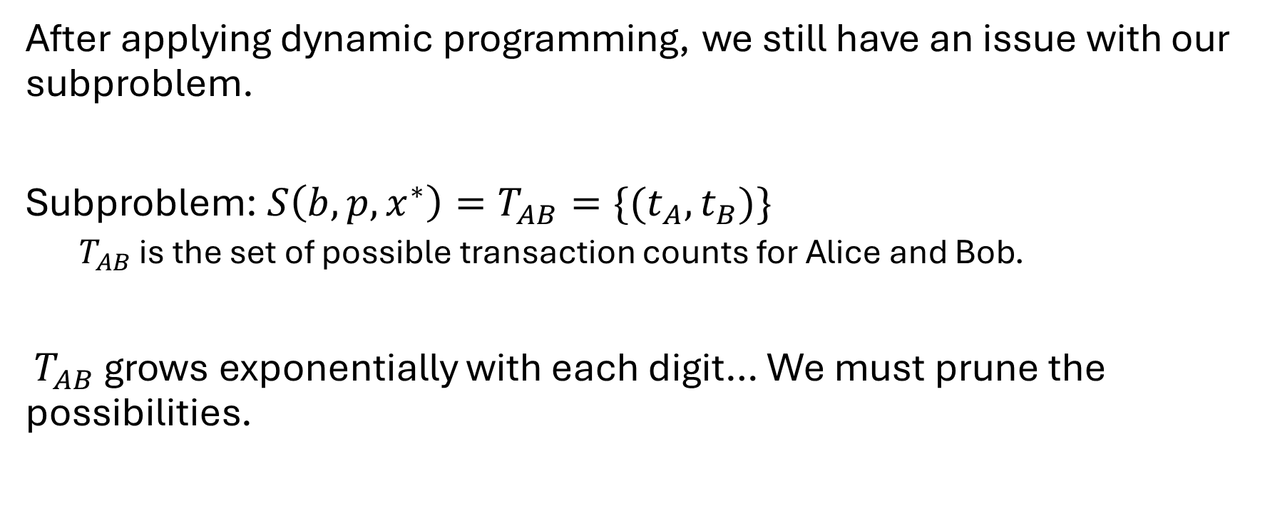
Not Finished Yet! Too Many Possibilities…
After applying dynamic programming, we still have an issue with our subproblem.
Subproblem: $S\left(b,p,x^{∗}\right)=T_{AB}=\{{(t}_{A},t_{B})\}$
$T_{AB}$ is the set of possible transaction counts for Alice and Bob.
$T_{AB}$ grows exponentially with each digit… We must prune the possibilities.

Slide 23
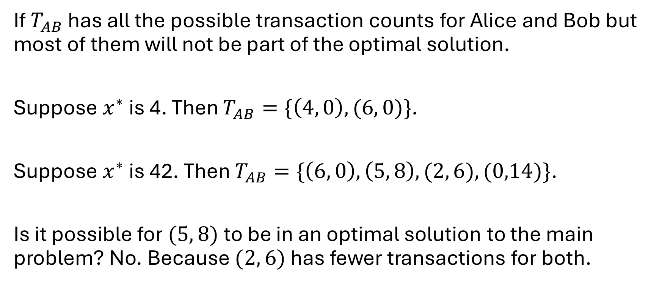

Pruning Possibilities in $T_{AB}$
If $T_{AB}$ has all the possible transaction counts for Alice and Bob but most of them will not be part of the optimal solution.
Suppose $x^{∗}$ is 4. Then $T_{AB}=\{\left(4, 0\right), (6, 0)\}$.
Suppose $x^{∗}$ is 42. Then $T_{AB}=\{\left(6, 0\right), \left(5, 8\right),(2, 6), (0,14)\}$.
Is it possible for $(5, 8)$ to be in an optimal solution to the main problem? No. Because $(2, 6)$ has fewer transactions for both.

Slide 24
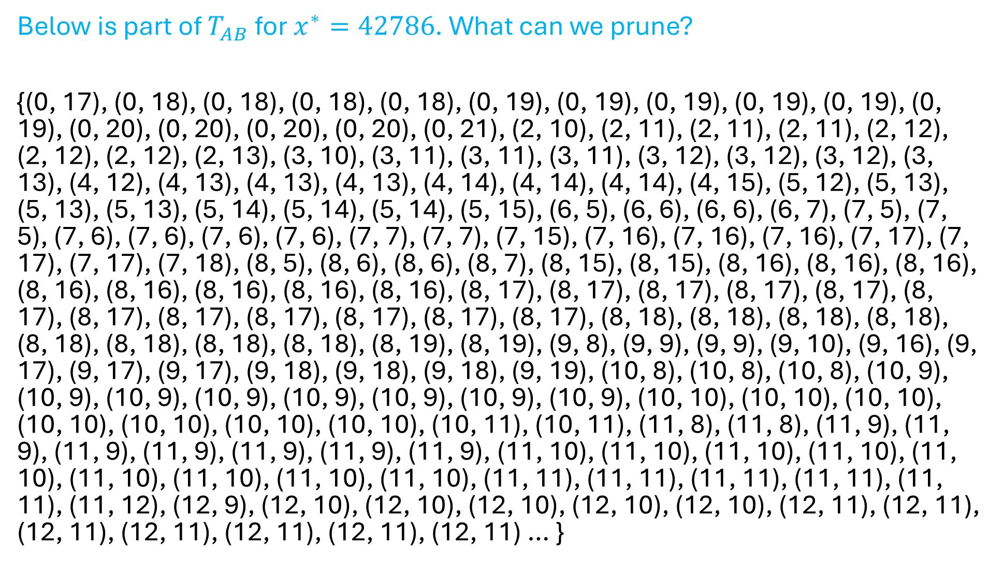
Below is part of $T_{AB}$ for $x^{∗}=42786$. What can we prune?
{(0, 17), (0, 18), (0, 18), (0, 18), (0, 18), (0, 19), (0, 19), (0, 19), (0, 19), (0, 19), (0, 19), (0, 20), (0, 20), (0, 20), (0, 20), (0, 21), (2, 10), (2, 11), (2, 11), (2, 11), (2, 12), (2, 12), (2, 12), (2, 13), (3, 10), (3, 11), (3, 11), (3, 11), (3, 12), (3, 12), (3, 12), (3, 13), (4, 12), (4, 13), (4, 13), (4, 13), (4, 14), (4, 14), (4, 14), (4, 15), (5, 12), (5, 13), (5, 13), (5, 13), (5, 14), (5, 14), (5, 14), (5, 15), (6, 5), (6, 6), (6, 6), (6, 7), (7, 5), (7, 5), (7, 6), (7, 6), (7, 6), (7, 6), (7, 7), (7, 7), (7, 15), (7, 16), (7, 16), (7, 16), (7, 17), (7, 17), (7, 17), (7, 18), (8, 5), (8, 6), (8, 6), (8, 7), (8, 15), (8, 15), (8, 16), (8, 16), (8, 16), (8, 16), (8, 16), (8, 16), (8, 16), (8, 16), (8, 17), (8, 17), (8, 17), (8, 17), (8, 17), (8, 17), (8, 17), (8, 17), (8, 17), (8, 17), (8, 17), (8, 17), (8, 18), (8, 18), (8, 18), (8, 18), (8, 18), (8, 18), (8, 18), (8, 18), (8, 19), (8, 19), (9, 8), (9, 9), (9, 9), (9, 10), (9, 16), (9, 17), (9, 17), (9, 17), (9, 18), (9, 18), (9, 18), (9, 19), (10, 8), (10, 8), (10, 8), (10, 9), (10, 9), (10, 9), (10, 9), (10, 9), (10, 9), (10, 9), (10, 9), (10, 10), (10, 10), (10, 10), (10, 10), (10, 10), (10, 10), (10, 10), (10, 11), (10, 11), (11, 8), (11, 8), (11, 9), (11, 9), (11, 9), (11, 9), (11, 9), (11, 9), (11, 9), (11, 10), (11, 10), (11, 10), (11, 10), (11, 10), (11, 10), (11, 10), (11, 10), (11, 10), (11, 11), (11, 11), (11, 11), (11, 11), (11, 11), (11, 12), (12, 9), (12, 10), (12, 10), (12, 10), (12, 10), (12, 10), (12, 11), (12, 11), (12, 11), (12, 11), (12, 11), (12, 11), (12, 11) … }

Slide 25
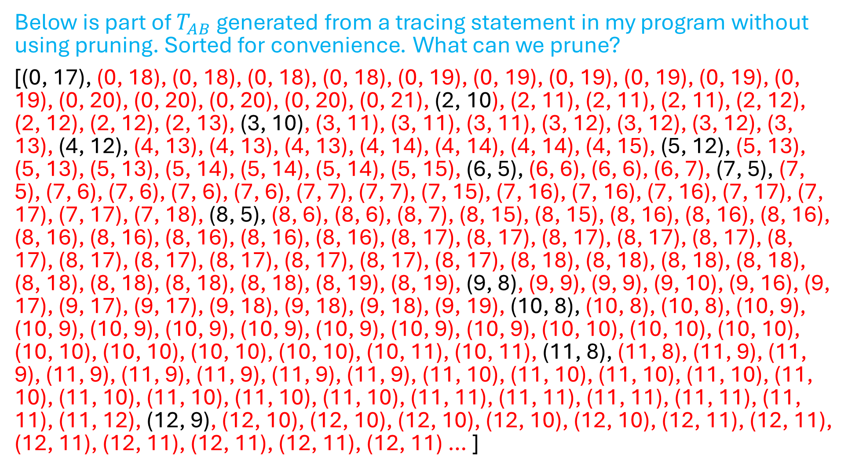
Below is part of $T_{AB}$ generated from a tracing statement in my program without using pruning. Sorted for convenience. What can we prune?
[(0, 17), (0, 18), (0, 18), (0, 18), (0, 18), (0, 19), (0, 19), (0, 19), (0, 19), (0, 19), (0, 19), (0, 20), (0, 20), (0, 20), (0, 20), (0, 21), (2, 10), (2, 11), (2, 11), (2, 11), (2, 12), (2, 12), (2, 12), (2, 13), (3, 10), (3, 11), (3, 11), (3, 11), (3, 12), (3, 12), (3, 12), (3, 13), (4, 12), (4, 13), (4, 13), (4, 13), (4, 14), (4, 14), (4, 14), (4, 15), (5, 12), (5, 13), (5, 13), (5, 13), (5, 14), (5, 14), (5, 14), (5, 15), (6, 5), (6, 6), (6, 6), (6, 7), (7, 5), (7, 5), (7, 6), (7, 6), (7, 6), (7, 6), (7, 7), (7, 7), (7, 15), (7, 16), (7, 16), (7, 16), (7, 17), (7, 17), (7, 17), (7, 18), (8, 5), (8, 6), (8, 6), (8, 7), (8, 15), (8, 15), (8, 16), (8, 16), (8, 16), (8, 16), (8, 16), (8, 16), (8, 16), (8, 16), (8, 17), (8, 17), (8, 17), (8, 17), (8, 17), (8, 17), (8, 17), (8, 17), (8, 17), (8, 17), (8, 17), (8, 17), (8, 18), (8, 18), (8, 18), (8, 18), (8, 18), (8, 18), (8, 18), (8, 18), (8, 19), (8, 19), (9, 8), (9, 9), (9, 9), (9, 10), (9, 16), (9, 17), (9, 17), (9, 17), (9, 18), (9, 18), (9, 18), (9, 19), (10, 8), (10, 8), (10, 8), (10, 9), (10, 9), (10, 9), (10, 9), (10, 9), (10, 9), (10, 9), (10, 9), (10, 10), (10, 10), (10, 10), (10, 10), (10, 10), (10, 10), (10, 10), (10, 11), (10, 11), (11, 8), (11, 8), (11, 9), (11, 9), (11, 9), (11, 9), (11, 9), (11, 9), (11, 9), (11, 10), (11, 10), (11, 10), (11, 10), (11, 10), (11, 10), (11, 10), (11, 10), (11, 10), (11, 11), (11, 11), (11, 11), (11, 11), (11, 11), (11, 12), (12, 9), (12, 10), (12, 10), (12, 10), (12, 10), (12, 10), (12, 11), (12, 11), (12, 11), (12, 11), (12, 11), (12, 11), (12, 11) … ]

Slide 26
We pruned out tuples that have greater value for Bob when Alice stays the same. What else can we prune?
[(0, 17), (0, 18), (0, 18), (0, 18), (0, 18), (0, 19), (0, 19), (0, 19), (0, 19), (0, 19), (0, 19), (0, 20), (0, 20), (0, 20), (0, 20), (0, 21), (2, 10), (2, 11), (2, 11), (2, 11), (2, 12), (2, 12), (2, 12), (2, 13), (3, 10), (3, 11), (3, 11), (3, 11), (3, 12), (3, 12), (3, 12), (3, 13), (4, 12), (4, 13), (4, 13), (4, 13), (4, 14), (4, 14), (4, 14), (4, 15), (5, 12), (5, 13), (5, 13), (5, 13), (5, 14), (5, 14), (5, 14), (5, 15), (6, 5), (6, 6), (6, 6), (6, 7), (7, 5), (7, 5), (7, 6), (7, 6), (7, 6), (7, 6), (7, 7), (7, 7), (7, 15), (7, 16), (7, 16), (7, 16), (7, 17), (7, 17), (7, 17), (7, 18), (8, 5), (8, 6), (8, 6), (8, 7), (8, 15), (8, 15), (8, 16), (8, 16), (8, 16), (8, 16), (8, 16), (8, 16), (8, 16), (8, 16), (8, 17), (8, 17), (8, 17), (8, 17), (8, 17), (8, 17), (8, 17), (8, 17), (8, 17), (8, 17), (8, 17), (8, 17), (8, 18), (8, 18), (8, 18), (8, 18), (8, 18), (8, 18), (8, 18), (8, 18), (8, 19), (8, 19), (9, 8), (9, 9), (9, 9), (9, 10), (9, 16), (9, 17), (9, 17), (9, 17), (9, 18), (9, 18), (9, 18), (9, 19), (10, 8), (10, 8), (10, 8), (10, 9), (10, 9), (10, 9), (10, 9), (10, 9), (10, 9), (10, 9), (10, 9), (10, 10), (10, 10), (10, 10), (10, 10), (10, 10), (10, 10), (10, 10), (10, 11), (10, 11), (11, 8), (11, 8), (11, 9), (11, 9), (11, 9), (11, 9), (11, 9), (11, 9), (11, 9), (11, 10), (11, 10), (11, 10), (11, 10), (11, 10), (11, 10), (11, 10), (11, 10), (11, 10), (11, 11), (11, 11), (11, 11), (11, 11), (11, 11), (11, 12), (12, 9), (12, 10), (12, 10), (12, 10), (12, 10), (12, 10), (12, 11), (12, 11), (12, 11), (12, 11), (12, 11), (12, 11), (12, 11) … ]

Slide 27
Pruning
Sort the possible transaction counts.
For each value for Alice, only keep the tuple that has Bob’s minimum value.
(0, 17), (0, 18), (0, 19)…
As Alice’s value increases, if Bob’s value doesn’t decrease, don’t include it.
(2, 10), (3, 10), (4, 12), (5, 12)…

